Slide 1




AI SaaS & Micro SaaS
Building scalable AI products from niche ideas

Slide 2


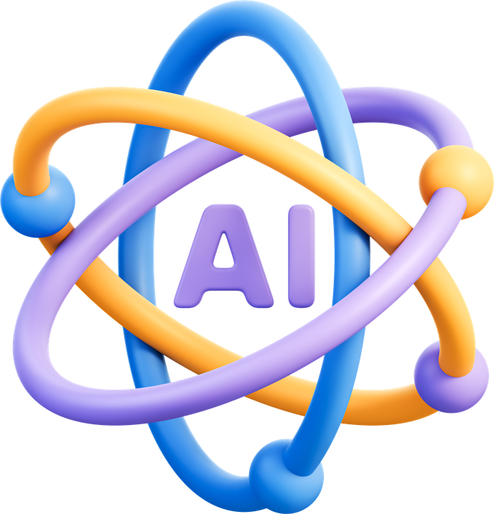
What is AI?
AI = software that can “think” and “learn patterns”
It can:
Example:
Understand text
Generate content
Make simple decisions

Slide 3



What is SaaS?
SaaS = software you use through internet + No installation needed
Example:

Slide 4





AI SaaS
AI SaaS = software + AI together
It doesn’t just store data → it does work for you
Example:
Writes emails automatically
Answers customer queries
Creates images/videos

Slide 5

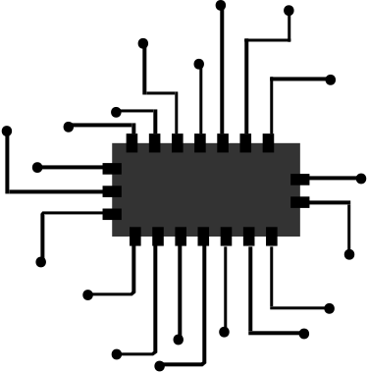
Micro SaaS
Small software solving one specific problem
Built for a small group of users
Example:
Tool to send WhatsApp reminders for shops
Tool to track gym members

Slide 6
Micro SaaS
Small software solving one specific problem
Built for a small group of users
Example:
Tool to send WhatsApp reminders for shops
Tool to track gym members

Slide 7




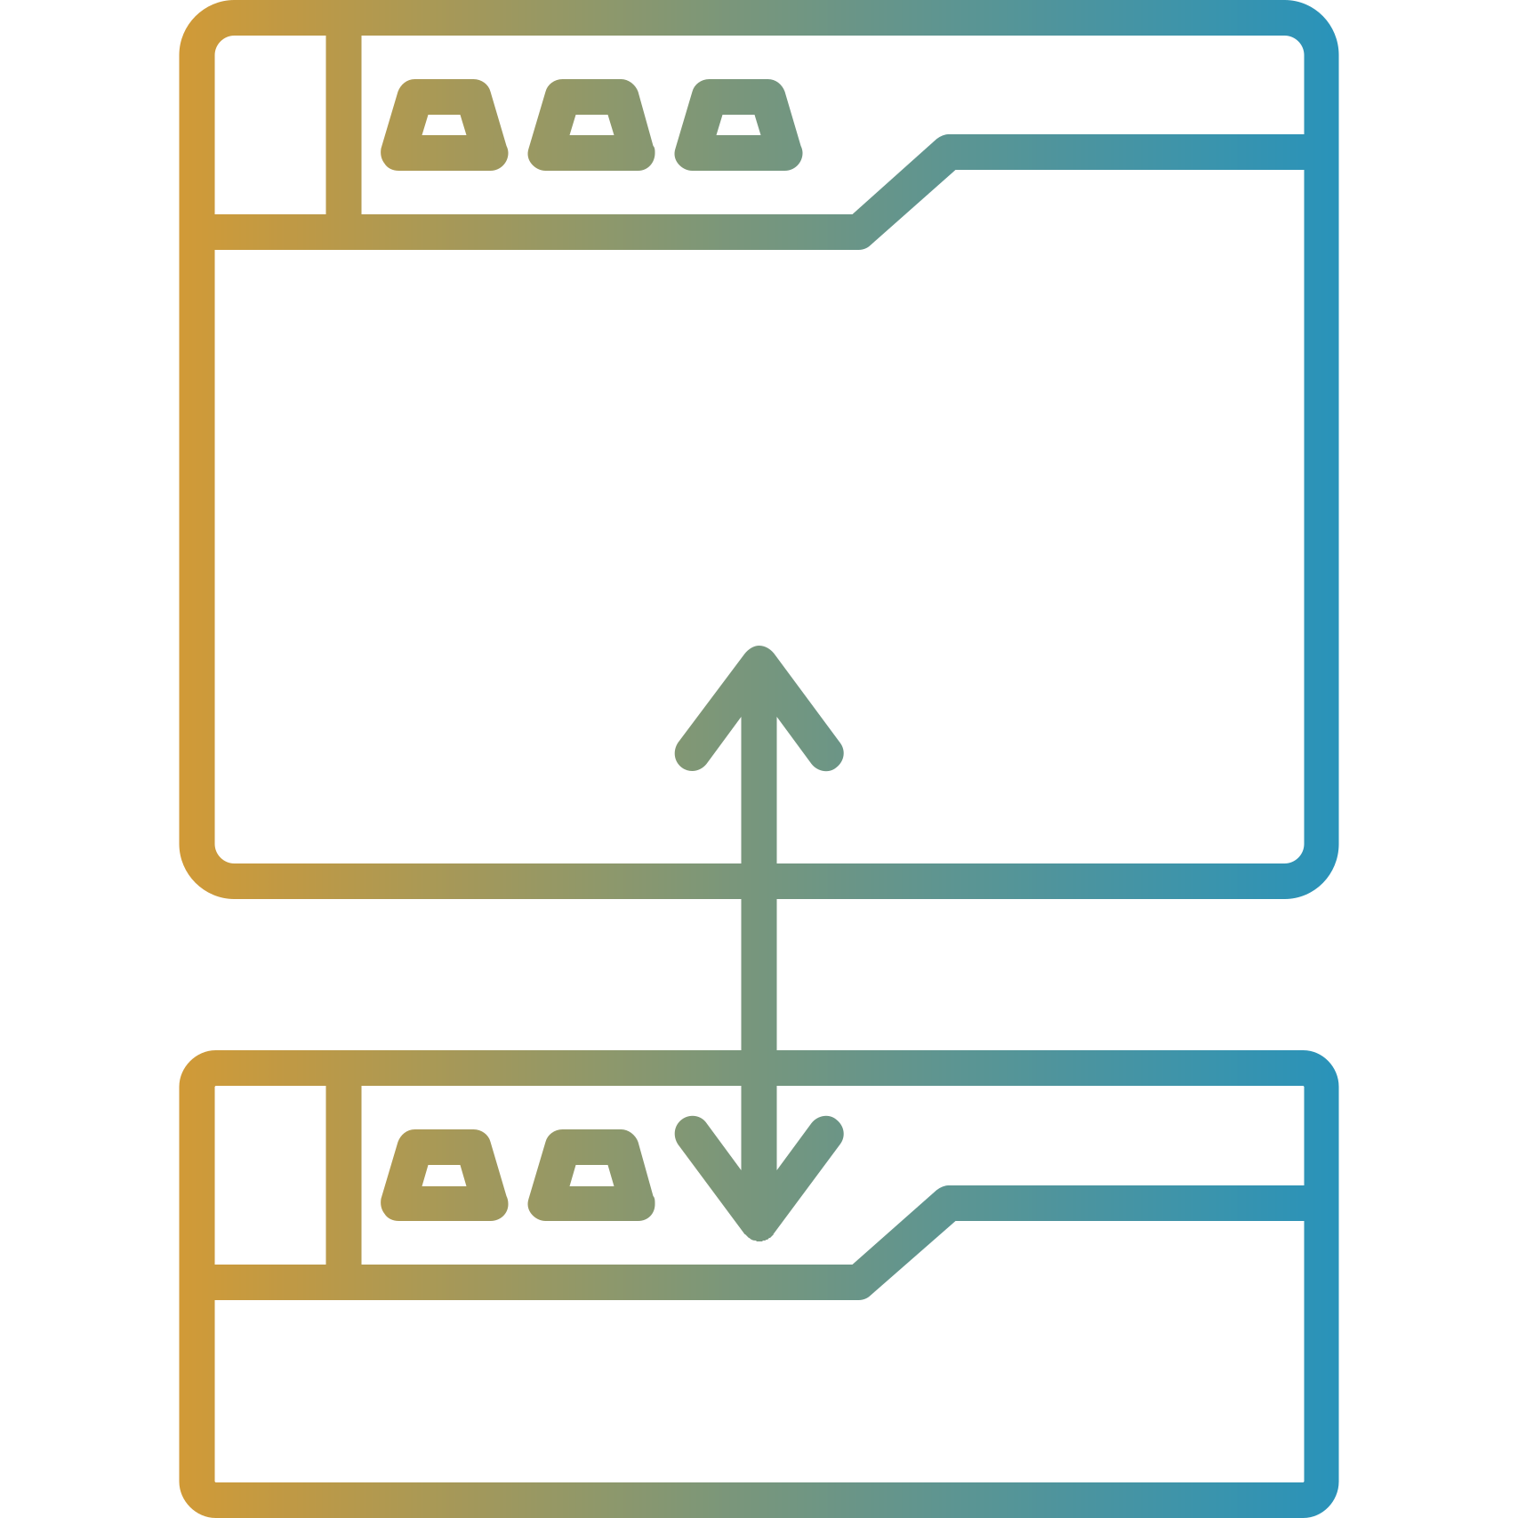

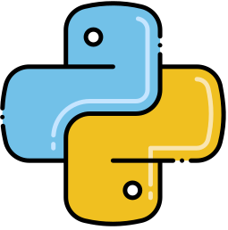
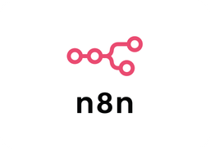
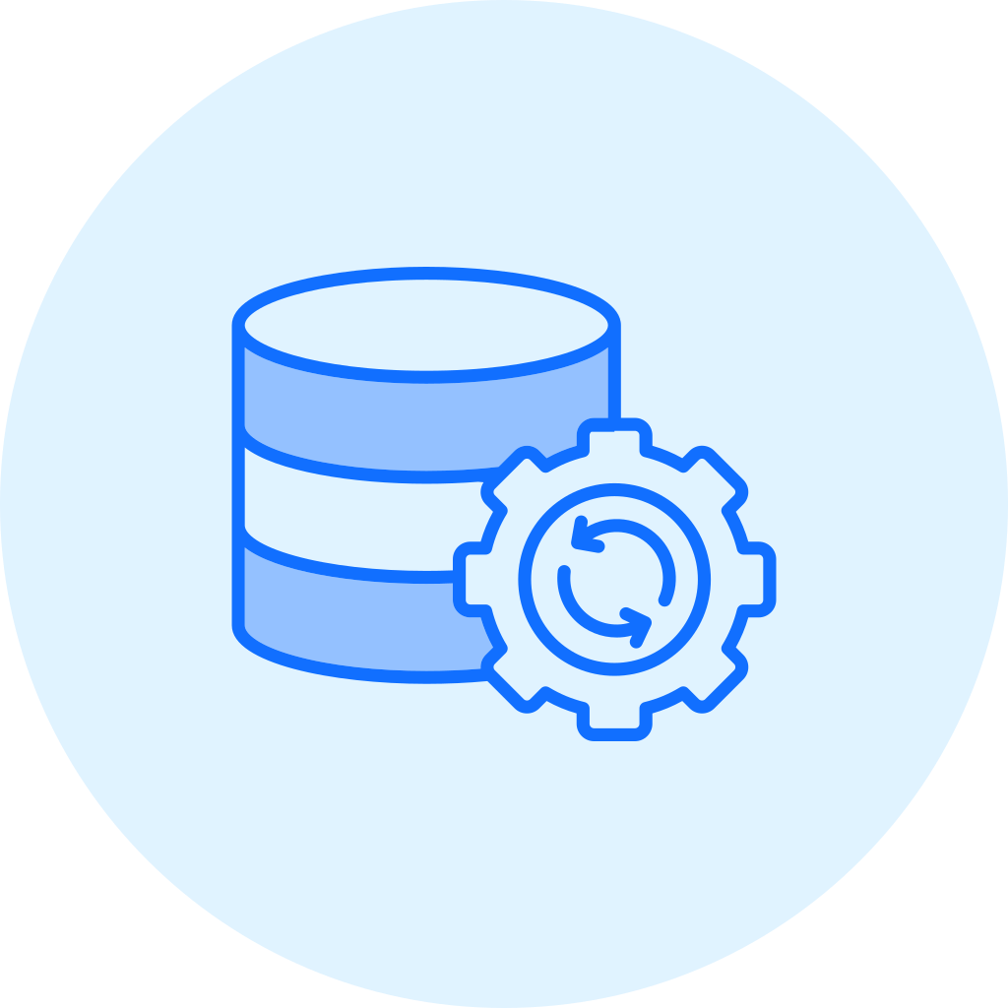

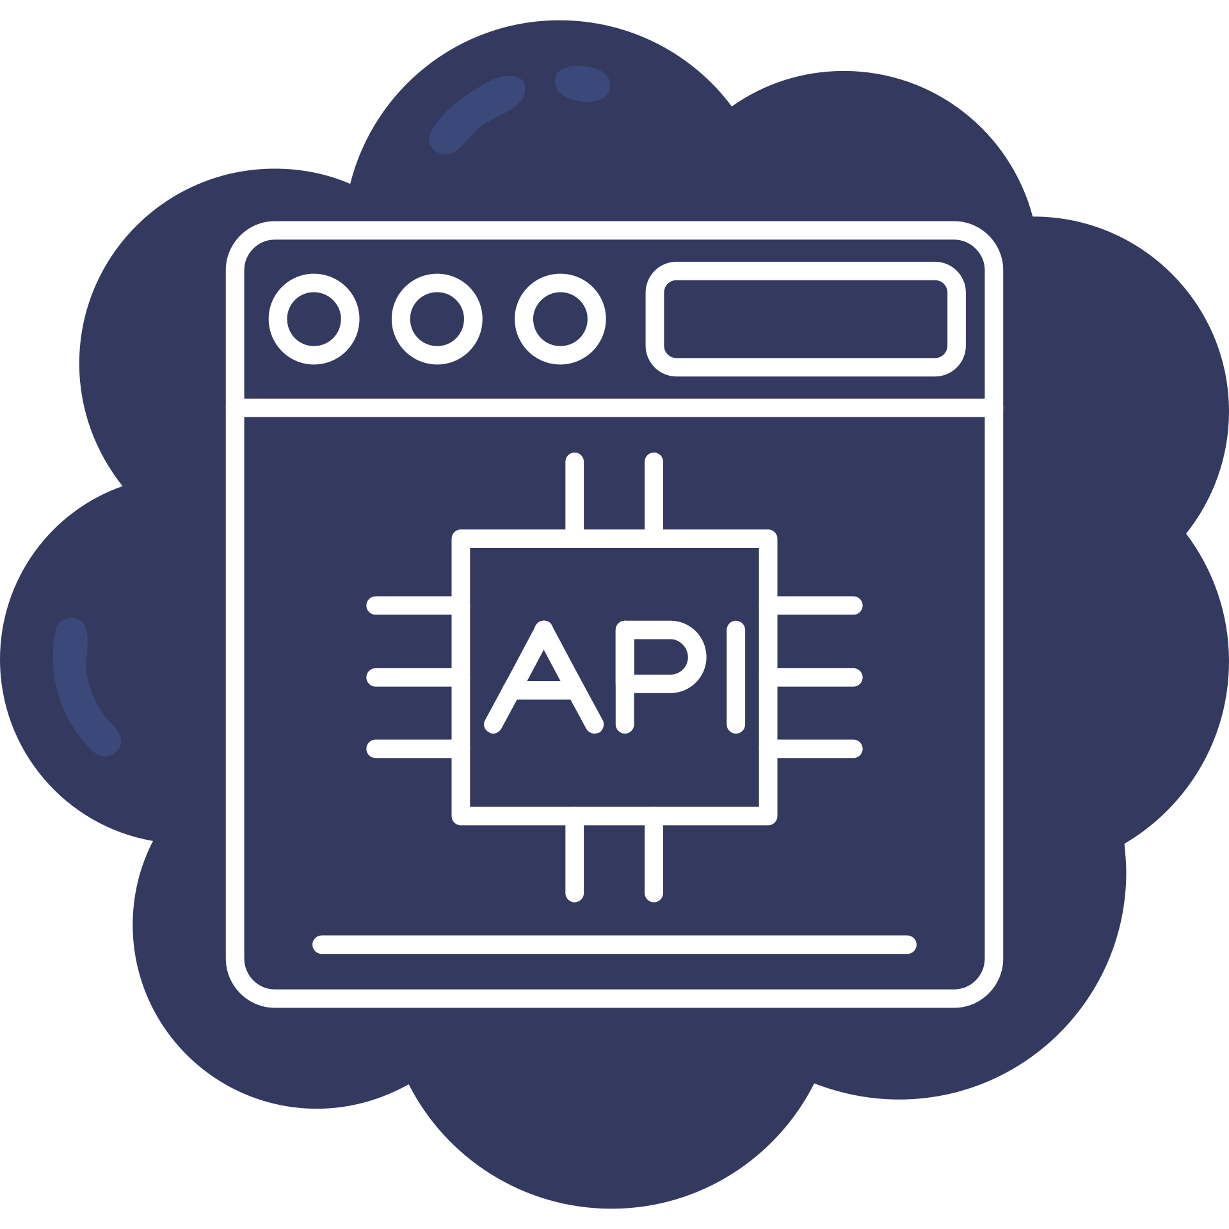



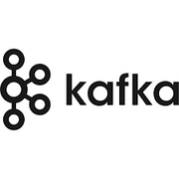



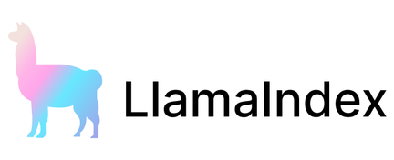
Must-Know Tech for Building AI SaaS

Slide 8

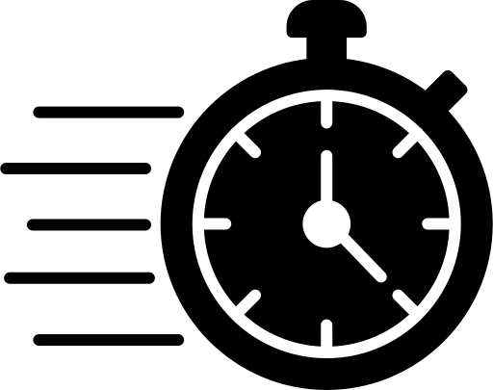


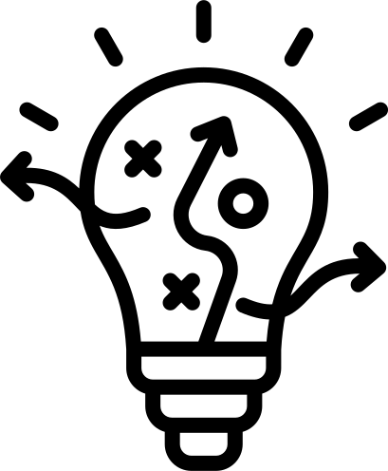
Why It Matters Today
Saves time
Reduces manual work
Helps small businesses grow faster
Anyone can build tools now

Slide 9

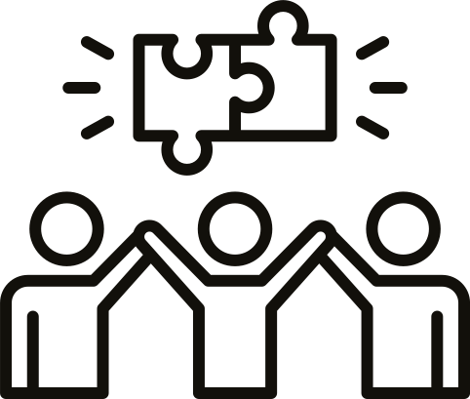
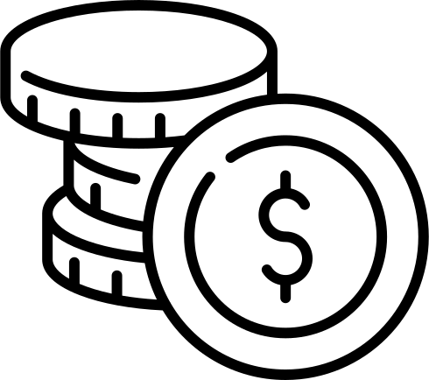

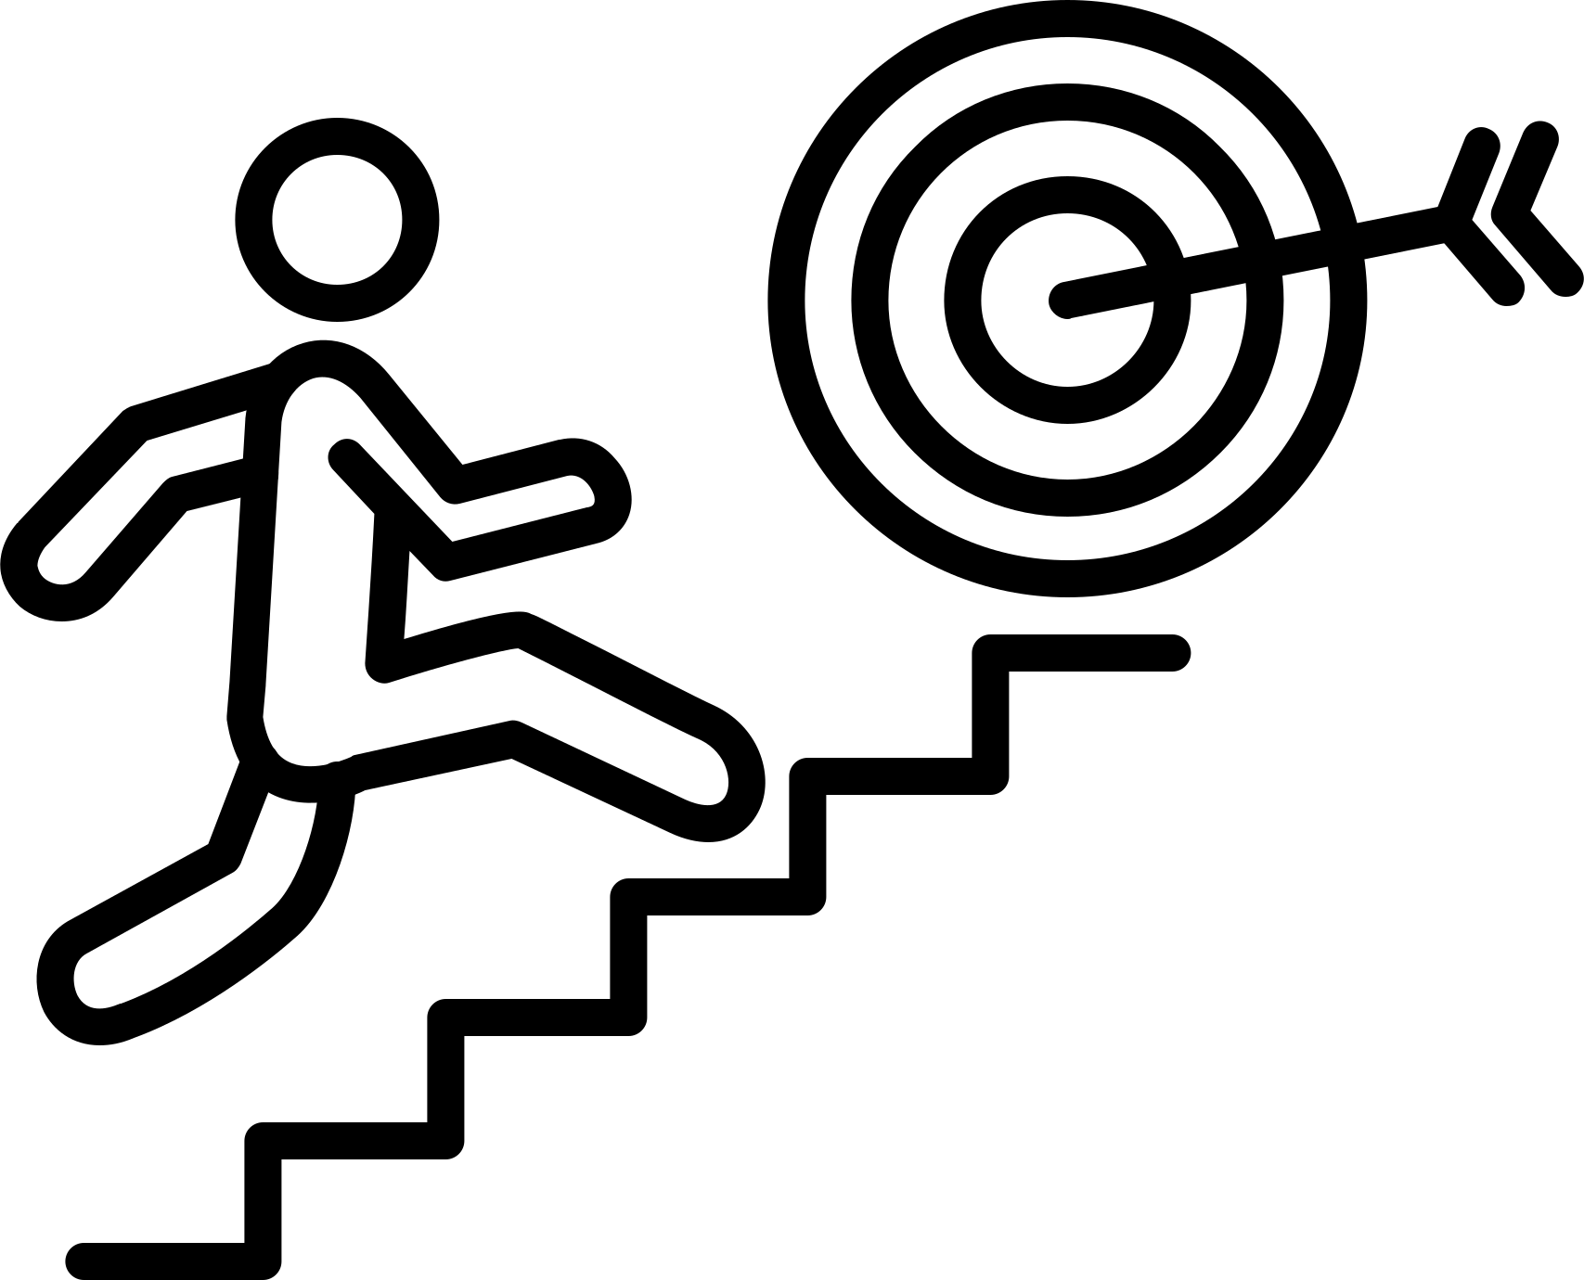
Why Micro SaaS is Powerful
Focus on one small problem
Easier to build
Faster to earn money
Less competition

Slide 10
Earlier software needed effort.
Now software does the effort for you.

